Slide 1
Tackling Usability Challenges in Querying Massive, Ultra-heterogeneous Graphs
Chengkai Li
Associate Professor, Department of Computer Science and Engineering
Director, Innovative Database and Information Systems Research (IDIR) Laboratory
University of Texas at Arlington
North Carolina State University, Feb. 9th, 2016

Slide 2
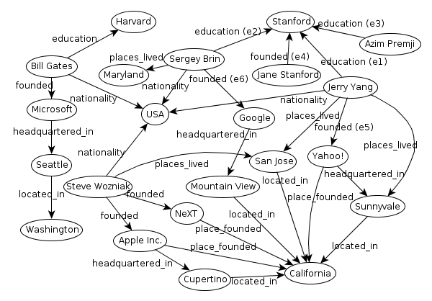
Ultra-heterogeneous Entity Graphs
Large, complex and schema-less graphs capturing millions of entities and billions of relationships between entities.
entity
relationship
Linked Open Data : 52 billion RDF triples
Freebase : 1.8 billion triples
DBpedia : 470 million triples
Yago : 120 million triples

Slide 3
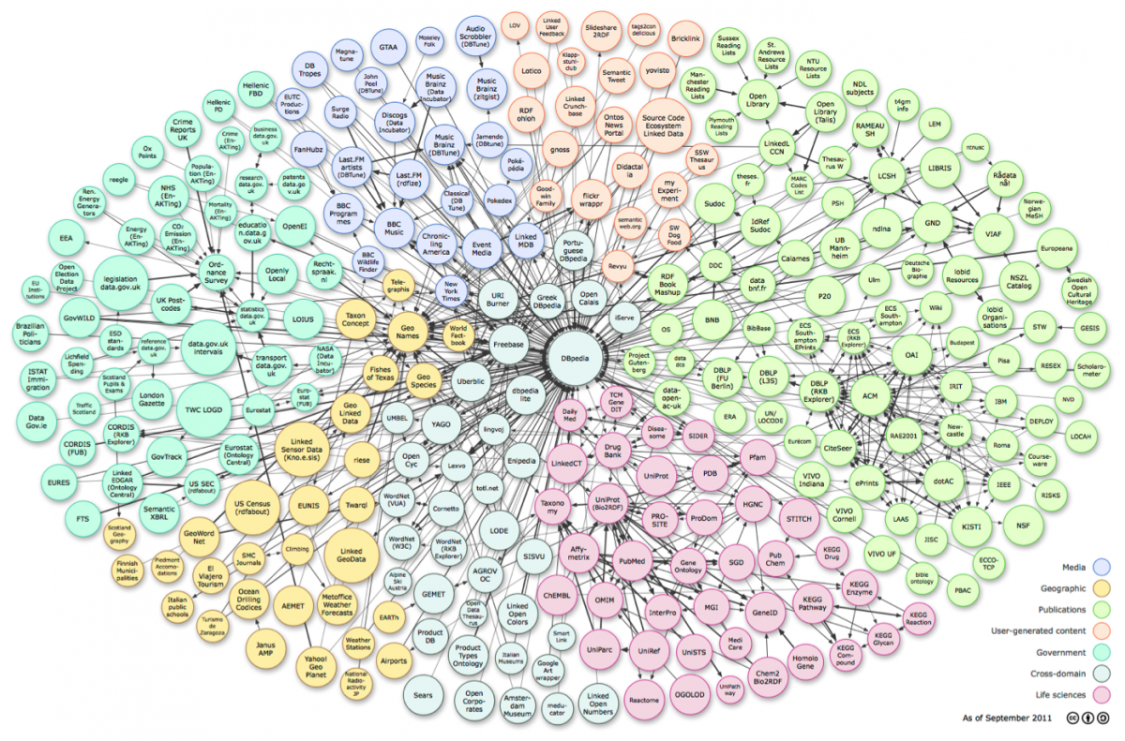
Linked Open Data
http://linkeddata.org/ (hundreds of datasets, billions of RDF triples)

Slide 4
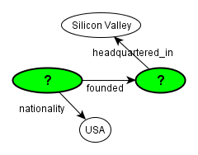
Structured Queries are Difficult to Write
SQL QUERY:
SELECT Founder.subj, Founder.obj
FROM Founder,
Nationality,
HeadquarteredIn
WHERE
Founder.subj = Nationality.subj AND
Founder.obj = HeadquarteredIn.subj
- Require knowledge on data
model, query language, and schema.
- Well-known usability challenges [Jagadish+07]
SPARQL QUERY:
SELECT ?company ?founder WHERE {
?founder dbo:founded ?company .
?founder dbo:nationality db:United_States .
?company dbprop:headquartered_in db:Silicon_Valley .
}

Slide 5
Simpler Query Paradigms
Keyword Search
[Kargar+11], BLINKS [He+07]
Challenging to articulate exact query intent by keywords
Approximate Query Answering
NESS [Khan+11]: uses neighborhood-based indexes to quickly find approximate matches to a query graph;
TALE [Tian+08]: approximate large graph matching
Users still have to formulate the initial query graph

Slide 6
Visual Query Builders
Relational Databases: CLIDE [Petropoulos+06]
Graph Databases: VOGUE [Bhowmick+13], PRAGUE [Jin+12], Gblender [Jin+10], GRAPHITE [Chau+08]
Single Large Graphs: QUBLE [Hung+13]
Require a good knowledge of the underlying schema
No automatic suggestions regarding what to include in the query graph

Slide 7
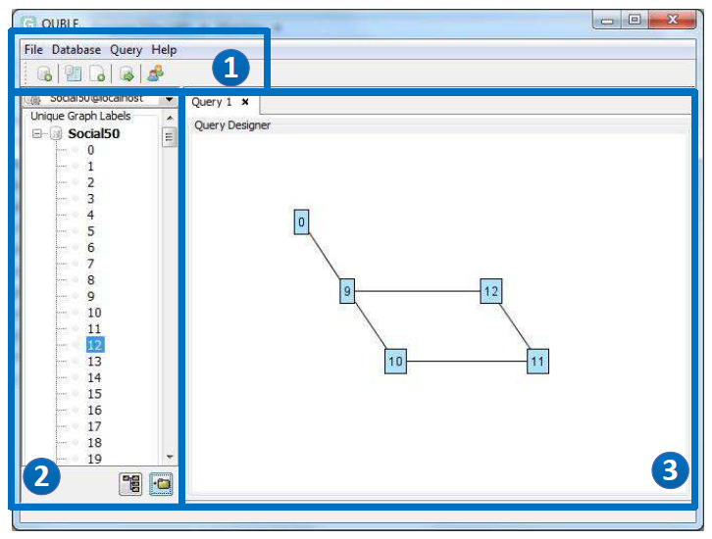
An Example: QUBLE

Slide 8
Orion: Auto-Suggestion Based Visual Interface for Interactive Query Construction

Slide 9


Orion
Prototype
http://idir.uta.edu/orion
Introduction Video
http://bit.ly/1O0GnNo

Slide 10
Objectives of Orion
Interactive GUI for building query components
Iteratively suggest edges based on their relevance to the user’s query intent, according to the partial query graph so far

Slide 11
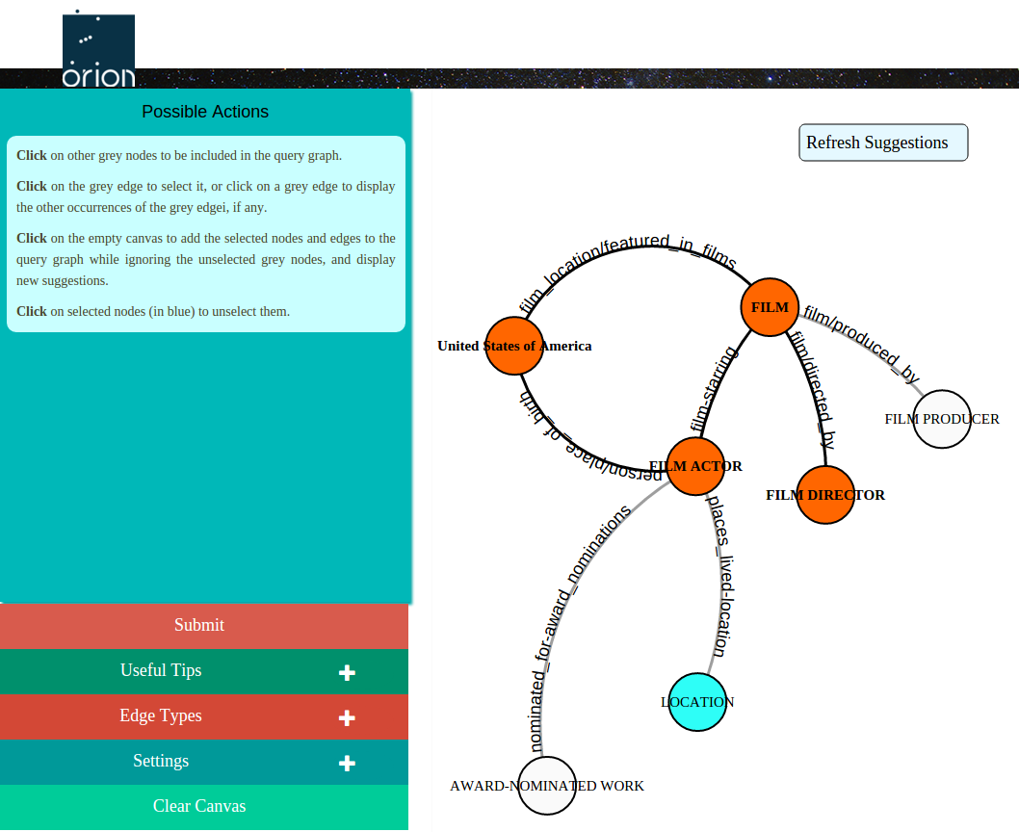
Orion GUI
Dynamic list of all possible user actions at any given moment
Control panel for various settings and tips

Slide 12
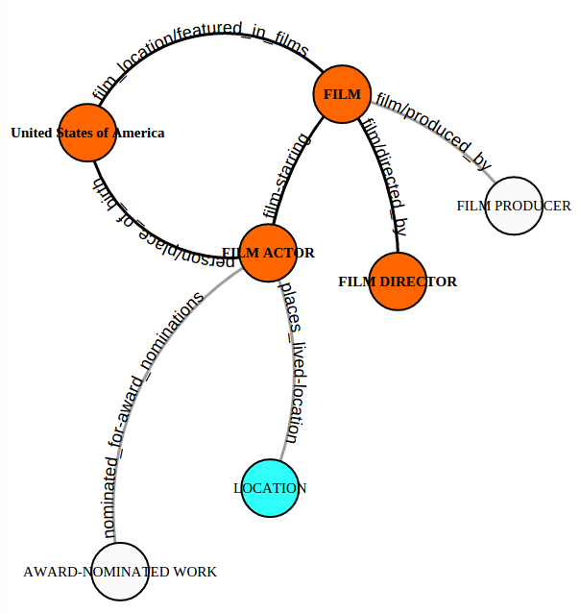
Active Mode
Grey edges and nodes automatically suggested in active mode:
Accepted by user (blue): positive edges
Ignored by user: negative edges

Slide 13
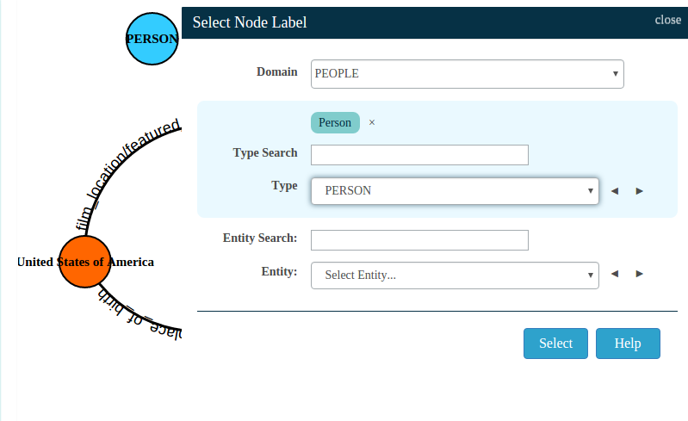
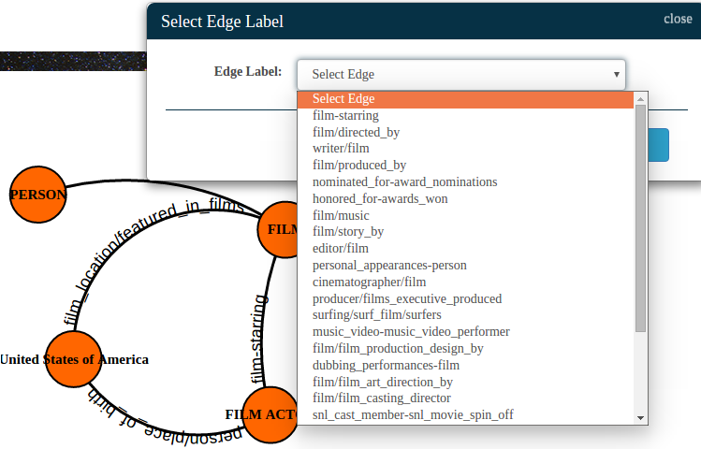
Passive Mode
A new edge added in passive mode
A new node added in passive mode

Slide 14
Rank Candidate Edges for Suggestions
Possible Solutions
Order alphabetically
Adapt standard machine learning algorithms
Naïve Bayes classifier
Random forests
Class association rules
Recommendation systems (based on SVD)
Query-specific Random Decision Paths (RDP)

Slide 15
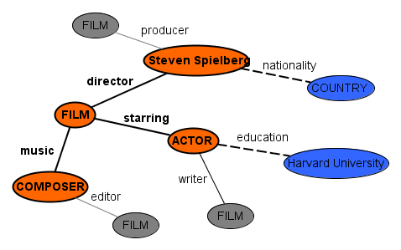
Concepts
Edges in partial query graph (positive edges)
starring, director, music
Edges rejected by users (negative edges)
education, nationality
Candidate edges
producer, writer, editor
Query Session:
<starring, director, music, education, nationality>

Slide 16
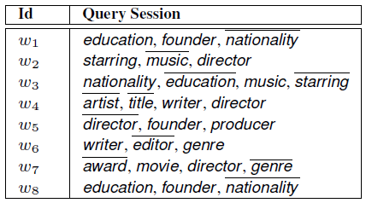
Concepts
Query Log (W)
Problem
Given a query log, a query session, and a set of candidate edges, rank the candidate edges by their relevance to the user’s query intent
Positive Edge
Negative Edge

Slide 17
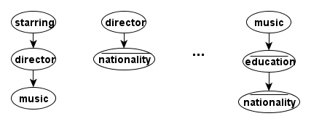
Random Decision Path (RDP)
<starring, director, music, education, nationality>
Choose edges from the query session randomly, to form RDPs
Each decision path selects a subset of the query log, with no more than ‘τ’ rows
Grow a path incrementally until its support in the query log drops below ‘τ’

Slide 18
Random Decision Path: Scoring
For each RDP, use its corresponding query log subset to compute the support of each candidate edge.
Final score of each candidate is its average score across all RDPs.
If R is the set of all RDPs:

Slide 19
Query Log
Nonexistent (almost)
Simulate and bootstrap
Find positive edges
Wikipedia and data graph
Data graph only
SPARQL query log [Morsey+11]
Inject negative edges

Slide 20
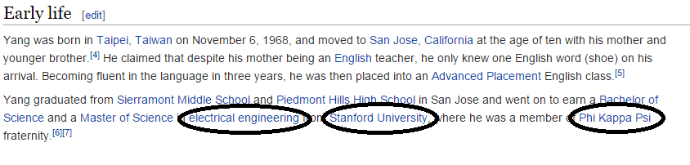
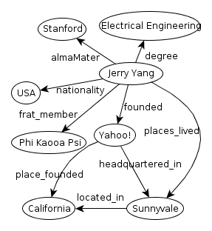
Query Log Simulation: Wikipedia + Data Graph
Use Sentences in Wikipedia Articles to Identify Positive Edges
Jerry Yang, Electrical Engineering, Stanford University, Phi Kappa Psi
Nodes Mapped:
<degree, almaMater, frat_member>

Slide 21
Query Log Simulation: Data Graph Only
Represent Each Node as an Itemset of Positive Edges
Generate Frequent Itemsets of Varying Sizes
Each frequent itemset of edges forms positive edges
<degree, almaMater, nationality, frat_member, founded, places_lived>
<founded, place_founded, headquartered_in>

Slide 22
Query Log Simulation: Injecting Negative Edges
Positive Edges List
(1) writer, starring, producer
(2) starring, editor, education
(3) editor, nationality, music
Inject Negative Edges
writer, starring, producer, editor, education (starring appears in 2)
starring, editor, education, writer, producer, nationality, music (starring appears in 1, and editor appears in 3)
editor, nationality, music, starring, education (editor appears in 2)

Slide 23
Experiments
System Configurations
Double quad-core 2.0 GHz Xeon server, 24 GB RAM
TACC: 5 Dell PowerEdge R910 server nodes, with 4 Intel Xeon E7540 2.0 GHz 6-core processors, 1 TB RAM
Datasets
Freebase (33 M edges, 30 M nodes, 5253 edge types)
DBpedia (12 M edges, 4 M nodes, 647 edge types)

Slide 24
Experiments (cont.)
User Studies
Orion (RDP) and Naïve
Edge Ranking Algorithms Compared
Random Decision Paths (RDP)
Naïve Bayes classifier (NB)
Random forest classifier (RF)
Class association rules (CAR)
SVD based recommendation system (SVD)

Slide 25
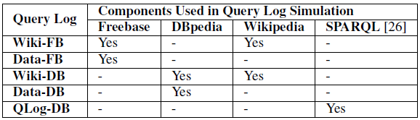
Query Logs Compared
Freebase: Wiki, Data
DBpedia: Wiki, Data, QLog

Slide 26
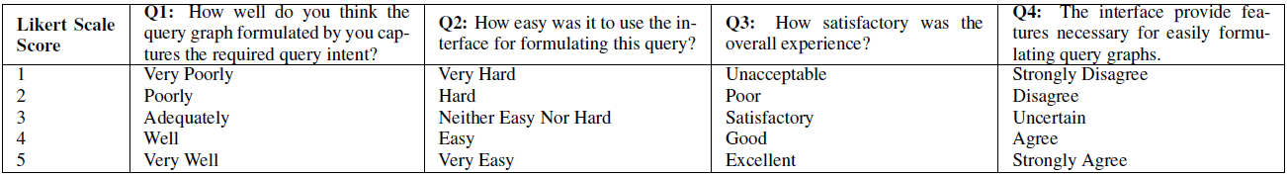
User Studies: Setup
15 Users for Orion, 15 Users for Naïve (A/B testing)
45 Easy, 30 Medium, and 30 Hard Query Tasks Designed
3 Easy, 2 Medium, 2 Hard Queries Assigned per Query Task
105 Query Tasks per System in Total
4 Survey Questions per Query Task

Slide 27
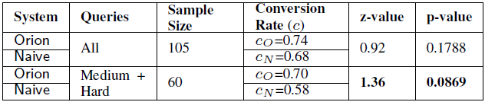
User Studies: Conversion Rate
Conversion Rate:
Percentage of query tasks completed successfully
Successful completion measured using edge isomorphism, and not a binary notion of matching
Orion has a higher conversion rate than Naïve for complex queries!

Slide 28
User Studies: Efficiency by Time
Time required to construct query graphs in Orion is comparable to Naïve in most cases, despite the steeper learning curve of Orion due to more features

Slide 29
User Studies: Efficiency by Number of Iterations
Time required to construct query graphs in Orion is comparable to Naïve in most cases, despite the steeper learning curve of Orion due to more features

Slide 30
User Studies: User Experience Results
As the difficulty level of the query graph being constructed increases, the usability of Orion seems significantly better than Naïve’s

Slide 31
Edge Ranking Algorithms
Simulates only Passive Mode
43 target query graphs for Freebase
6 two-edged, 10 three-edged, 9 four-edged, 17 five-edged, 1 six-edged (includes medium and hard queries from the user study)
167 input instances
33 target query graphs for DBpedia
2 three-edged, 29 four-edged, 2 five-edged
130 input instances

Slide 32
Edge Ranking Algorithms: Efficiency by Number of Suggestions
RDP requires only 40 suggestions, 1.5-4 times fewer than other methods
RDP requires fewer suggestions compared to all other methods

Slide 33
Edge Ranking Algorithms: Efficiency by Time
RDP better than RF and comparable to NB, despite RF and NB being light models
RDP significantly better than SVD and CAR, but worse than RF and NB

Slide 34
Query Logs Comparison
Positive edges better captured based on the context of human usage of relationships in Wikipedia
DBpedia is created using info-boxes in Wikipedia, and is thus very clean. Wiki-DB is highly similar to Data-DB for DBpedia

Slide 35
Tuning RDP Parameters
RDP performs better with more random decision paths and higher query log threshold
Considering negative edges in query session is important, as it results in better performance of RDP

Slide 36
Orion Contributions
Unique visual query builder with suggestions
Edge ranking algorithm : random decision paths
Query log simulation
Extensive user studies and experiments
Prototype available

Slide 37


GQBE: Graph Query by Example
Prototype
http://idir.uta.edu/gqbe
Introduction Video
http://bit.ly/1PLqLTD

Slide 38
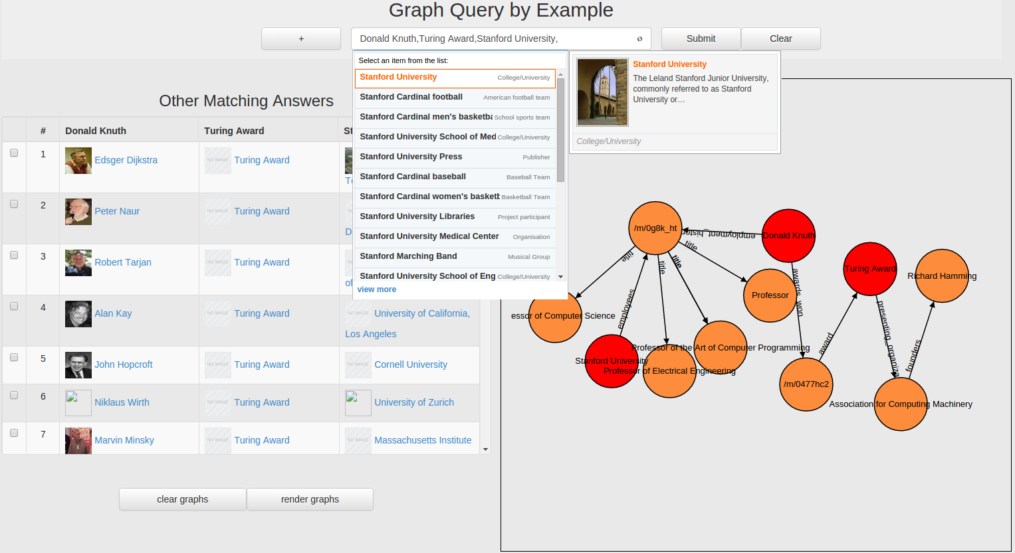
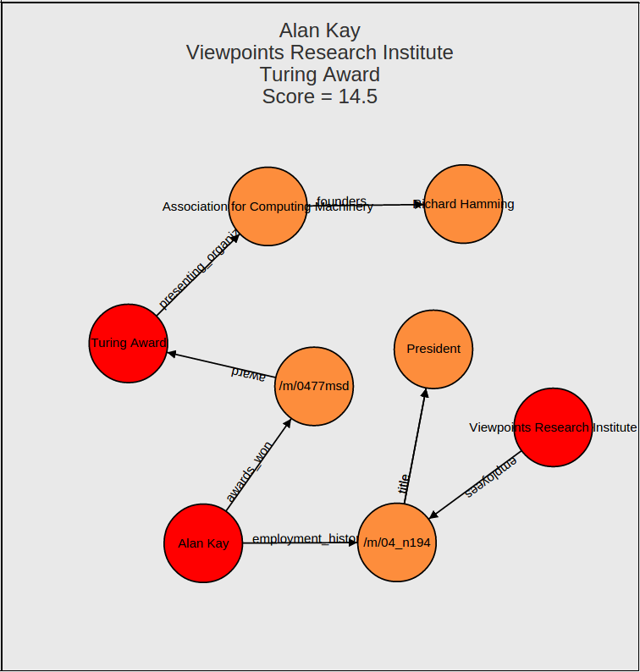
GQBE GUI
Ranked similar answer tuples
Keyword completion powered query interface
Query graph automatically discovered by the system
An example answer graph

Slide 39
TableView: Generating Preview Tables for Entity Graphs

Slide 40
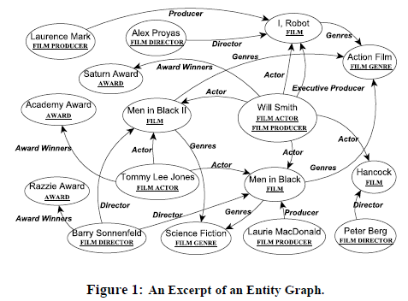
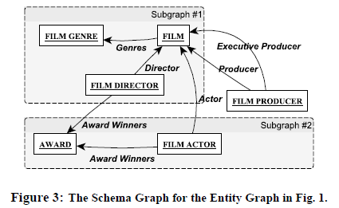
TableView

Slide 41
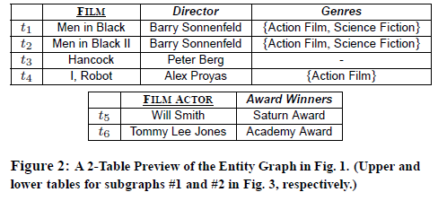
TableView

Slide 42
Publications
Overview
Intuitive and Interactive Query Formulation to Improve the Usability of Query Systems for Heterogeneous Graphs. Nandish Jayaram. VLDB 2015 PhD Workshop.
Orion
Auto-Suggestion Based Visual Interface for Interactive Query Construction on Ultra-Heterogeneous Graphs. Nandish Jayaram, Rohit Bhooplam, Chengkai Li, Vassilis Athitsos. Under preparation.
VIIQ: Auto-Suggestion Enabled Visual Interface for Interactive Graph Query Formulation. Nandish Jayaram, Sidharth Goyal, Chengkai Li. PVLDB, 8(12): 1940-1943, August 2015. Demonstration description.
GQBE
Querying knowledge graphs by example entity tuples (Extended Abstract). Nandish Jayaram, Arijit Khan, Chengkai Li, Xifeng Yan, Ramez Elmasri. ICDE 2016 (TKDE Poster)

Slide 43
Publications
GQBE (cont’d)
Querying knowledge graphs by example entity tuples. Nandish Jayaram, Arijit Khan, Chengkai Li, Xifeng Yan, Ramez Elmasri. TKDE, 27(10): 2797-2811, October 2015.
GQBE: Querying knowledge graphs by example entity tuples. Nandish Jayaram, Mahesh Gupta, Arijit Khan, Chengkai Li, Xifeng Yan, Ramez Elmasri. ICDE, pages 1250-1253, 2014. Demonstration description.
Towards a query-by-example system for knowledge graphs. Nandish Jayaram, Arijit Khan, Chengkai Li, Xifeng Yan, Ramez Elmasri. GRADES 2014.
TableView
Generating Preview Tables for Entity Graphs. Ning Yan, Abolfazl Asudeh, and Chengkai Li. Technical Report, arXiv:1403.5006, March 2014.

Slide 44



Acknowledgment
Funding sponsors
Disclaimer: This material is based upon work partially supported by the National Science Foundation Grants 1018865, 1117369, 1408928 and 1565699, 2011 and 2012 HP Labs Innovation Research Awards, the National Natural Science Foundation of China Grant 61370019, and Army Research Laboratory under cooperative agreement W911NF-09-2-0053 (NSCTA). Any opinions, findings, and conclusions or recommendations expressed in this material are those of the author(s) and do not necessarily reflect the views of the funding agencies.

Slide 45
Acknowledgment
UTA Students
Collaborators
Nandish Jayaram
Sona Hasani
Rohit Bhoopalam
Sidharth Goyal
Mahesh Gupta
Vassilis Athitsos (UTA)
Arijit Khan (NTU)
Ramez Elmasri (UTA)
Ning Yan (FutureWei, former student)
Xifeng Yan (UCSB)

Slide 46
Thank You! Questions?
http://ranger.uta.edu/~cli
cli@uta.edu
Prototypes
http://idir.uta.edu/orion
http://idir.uta.edu/gqbe

